Slide 1
The Evolution of Washington D.C

Slide 2
How have DC Neighborhoods Changed Over the Years?
Washington D.C has changed dramatically over the past 40 years
Neighborhoods that were once considered rough places to live have turned into high demand neighborhoods due to an improving economy, driven by both the federal and private sector jobs.
Understanding how demographics and social economic factors have changed over the past few years can help determine how which neighborhoods of Washington DC are best.
Understanding the relationship and trends of DC demographic data over time would be useful to political campaigns, merchants, potential home buyers, real-estate investors, and city planners.

Slide 3
Data Acquisition
Primary Dataset: http://data.codefordc.org
Demographic information by Neighborhood from 1980 to 2017 clustered by Neighborhood
Dataset includes Latitude and longitude values for each neighborhood for plotting geographic data
Key metrics
Population by Year | Unemployment Rate | % Population by ethnicity
Poverty Rate | Violent Crime per 1000 people | % Subprime Loans
Median Family Income | Property Rate | % Low Birth Rates
% Receive food stamps | Median Home Price of Single Family Homes | % Births to Teen Mothers

Slide 4
Data Cleansing and Feature Selection
The dataset contains 39 rows and 416 columns.
Set neighborhood name to index value
Because there are so many parameters in this data set, all analysis will be done on subsets of the primary dataset
Sum, Average, and percent change rows and columns were added to data feature selections as needed to perform analysis

Slide 5
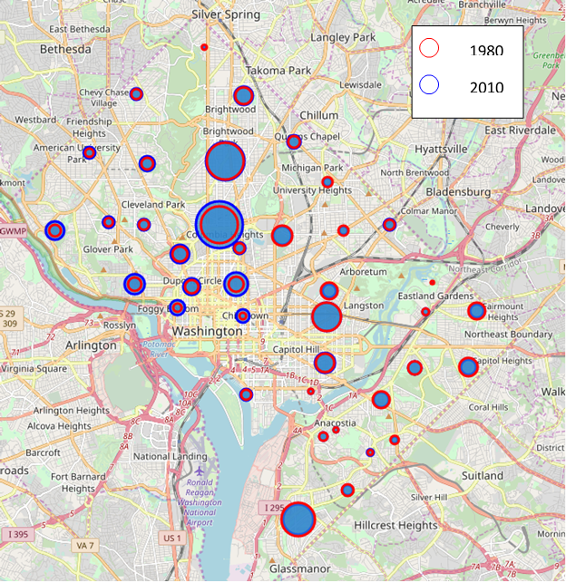
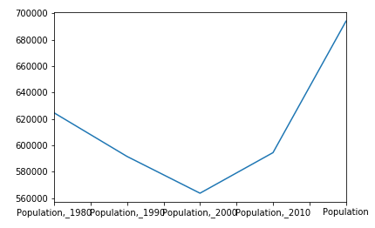
Population Change by Neighborhood
Population Change since 1980
Population Change by Neighborhood: 1980 - 2010

Slide 6
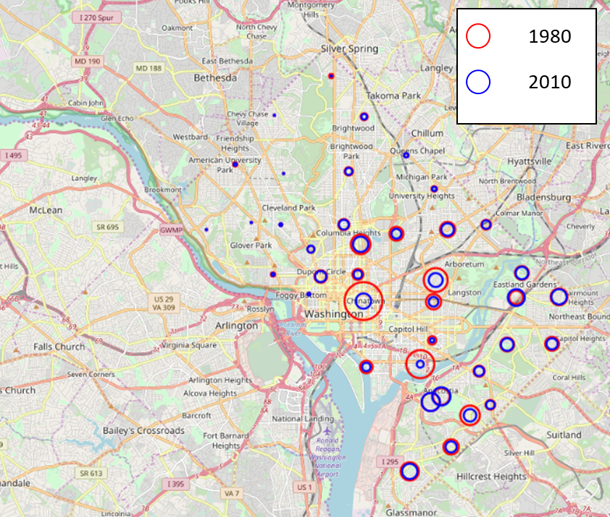
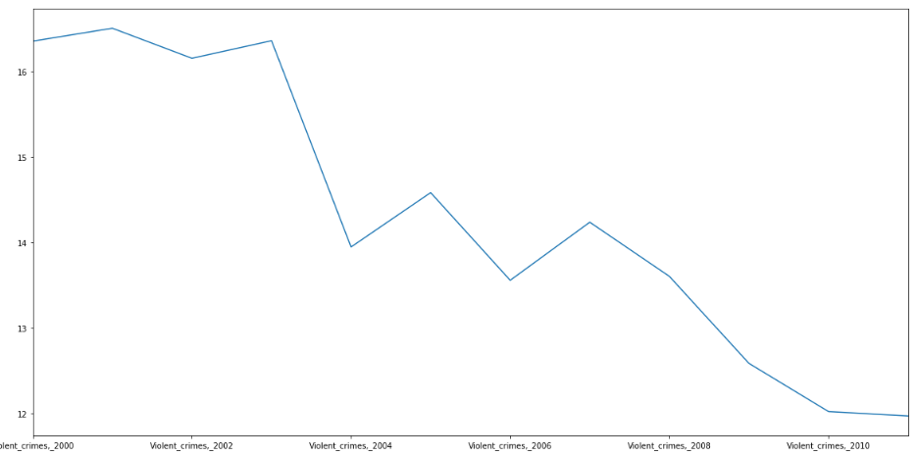
Violent Crime
Violent Crime Rate Change by Neighborhood: 1980 - 2010

Slide 7
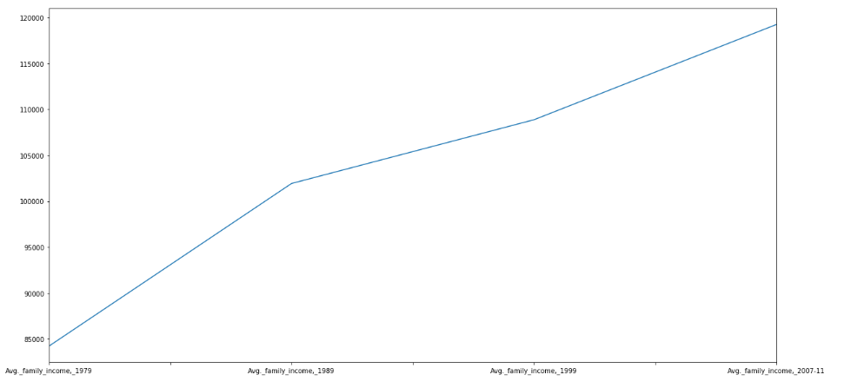
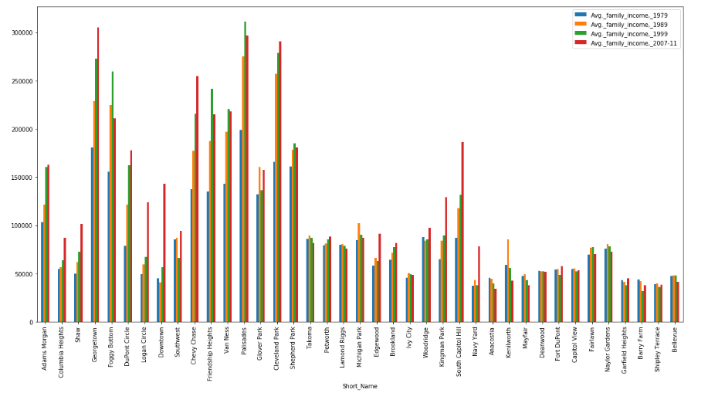
Median Household Income

Slide 8
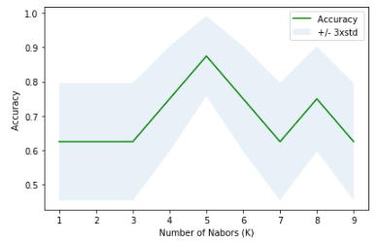
K Nearest Neighbor to Predict Income Level
Using crime levels and home sale price to predict household income level:
Result:
Train Set Accuracy: 1.0
Test Set Accuracy when K = 4: .75
The best accuracy was .875 with k = 5
Median Income | Income Level
$200000 and above | 3
$60001 to $199999 | 2
$60000 and below | 1

Slide 9
Conclusion
Built useful models to show how neighborhoods in Washington DC change over time and the relationships between different demographic metrics.
performed a KNN clustering model that was able to accurately predict median income level based on other environmental factors.
Next Steps
Explore the relationships between other parameters in the dataset to determine the causes of unfavorable socioeconomic conditions.

